Slide 1

Idea Generation
(HU-221)
Under The Guidance of :-
Mr. Anshul Oza

Slide 2

StackUp.com
Submitted By :-
Shakshi Thakur
(0802CS151098)
Shivani Shrivastava
(0802CS151104)

Slide 3
Introduction to
StackUp.com
Website : Stackup.html
Designed by : HTML and CSS
StackUp.com is a website containing test papers for
preparation of competitive examination.
It contains test papers for general aptitude, logical
reasoning, science etc.

Slide 4
Idea Behind StackUp.com
StackUp.com would be the preferred source of resources and
professionals for the students preparing for some competitive
examinations.
We provide you the best practice papers.
Also, we provide you the previous years question papers.
An ask now portal provides you the dynamic question answer
platform for your questions.

Slide 5
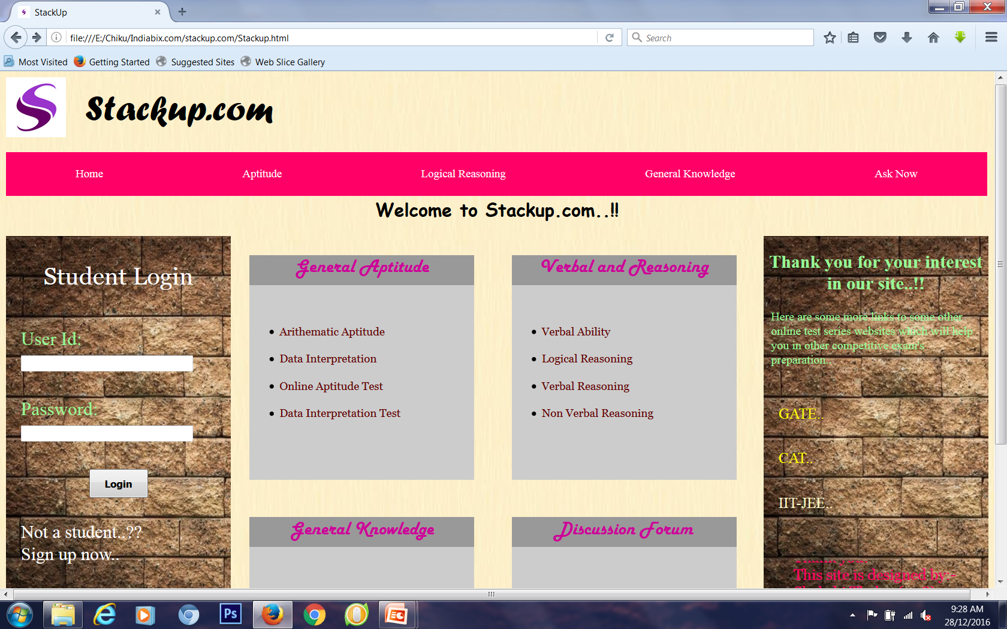
Home Page

Slide 6
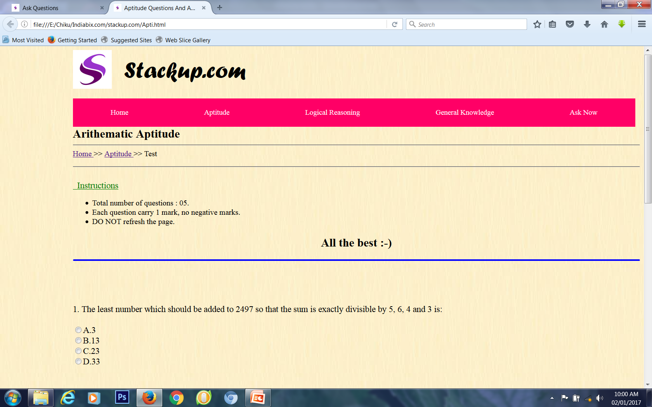
Aptitude Page

Slide 7
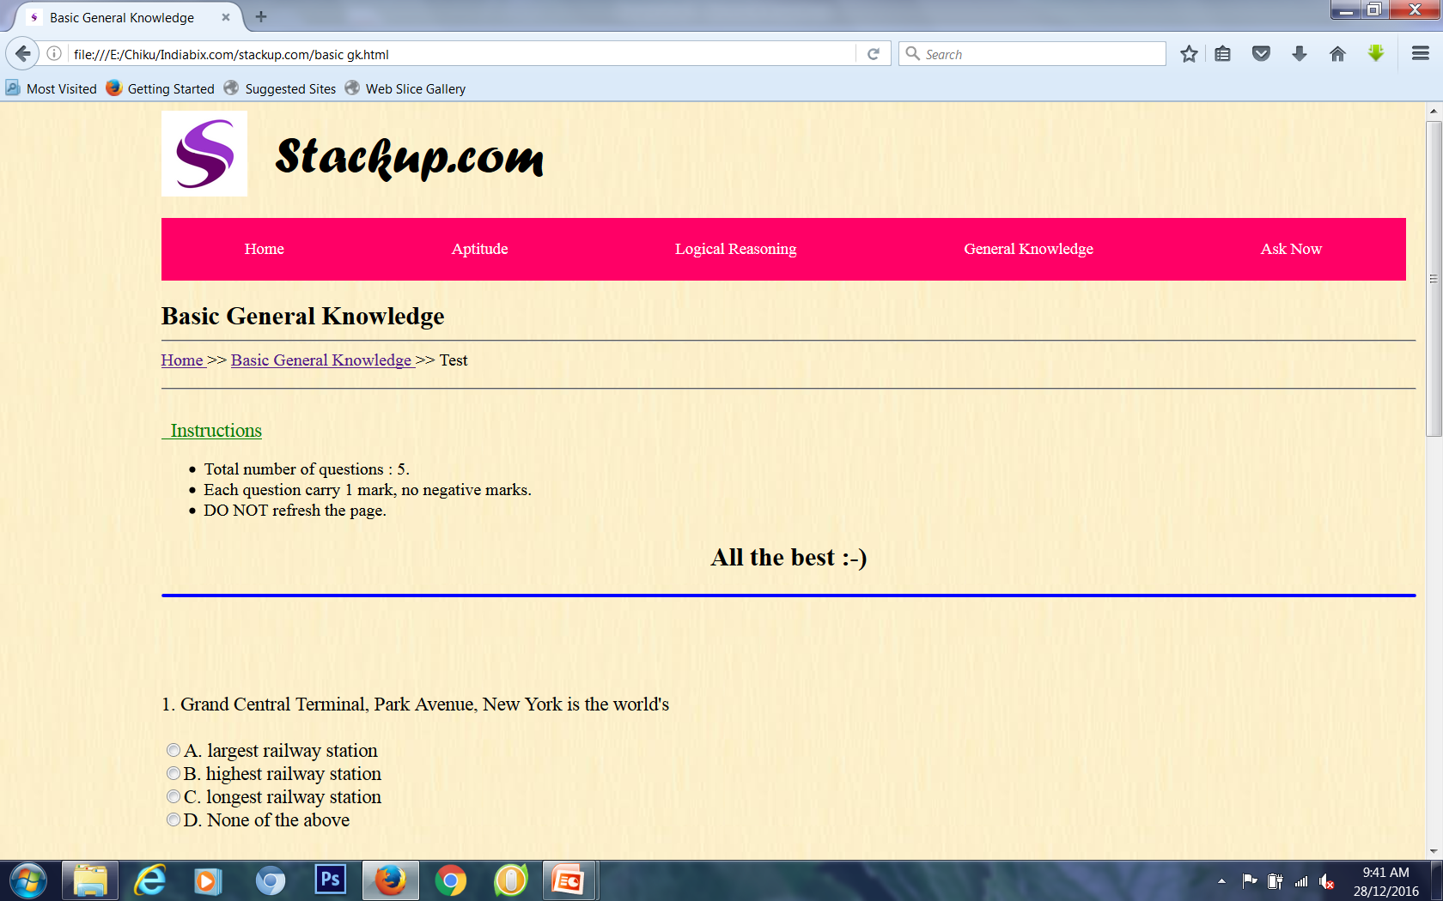
General Knowledge Page

Slide 8
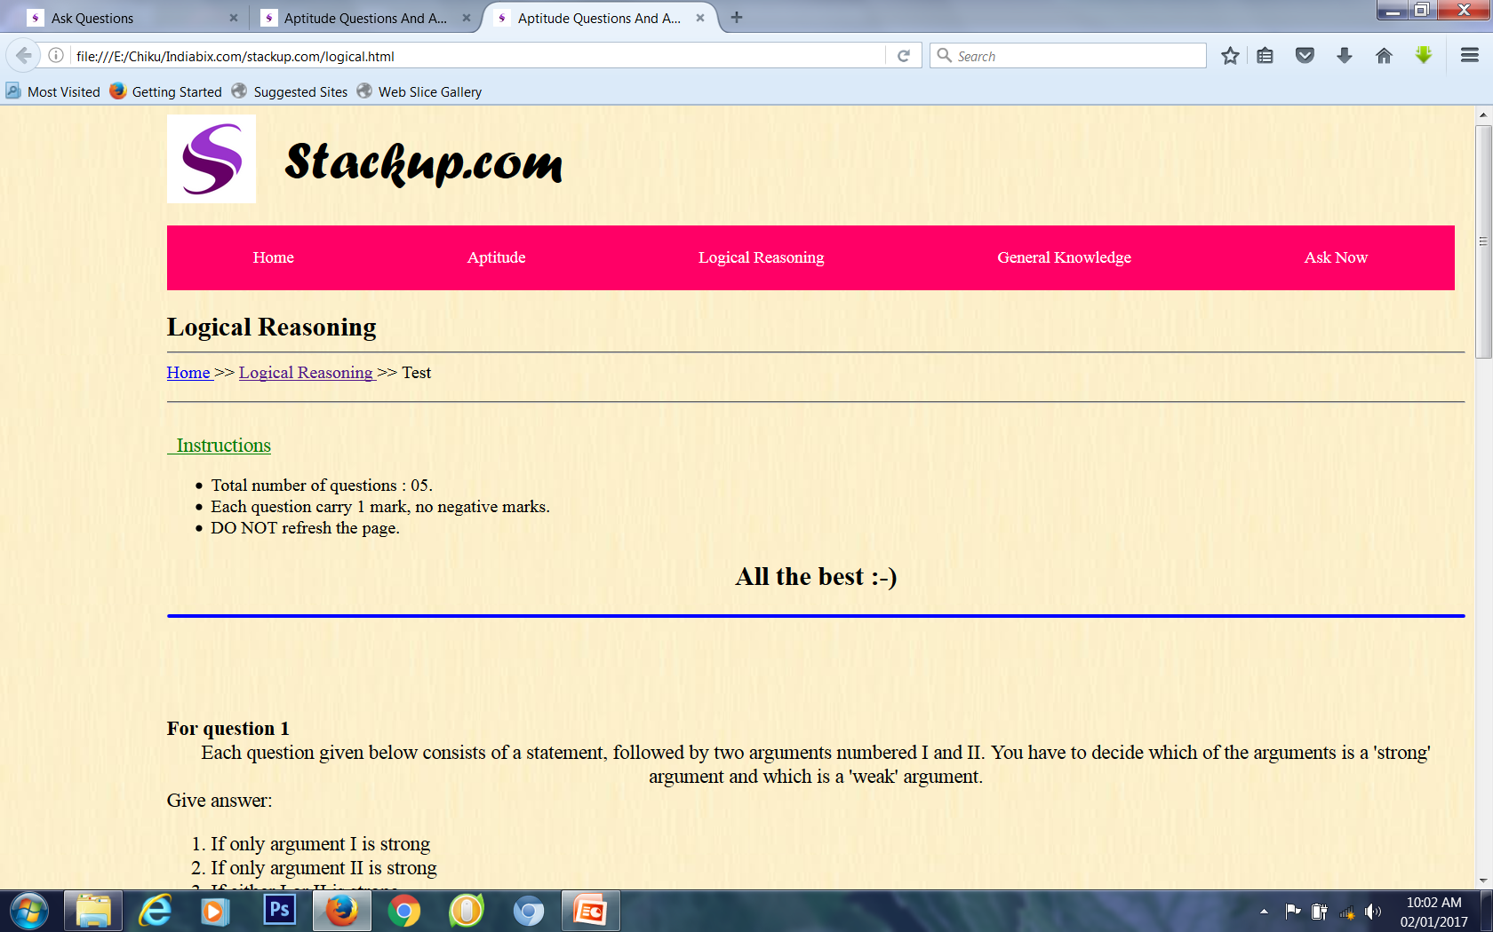
Logical Reasoning Page

Slide 9
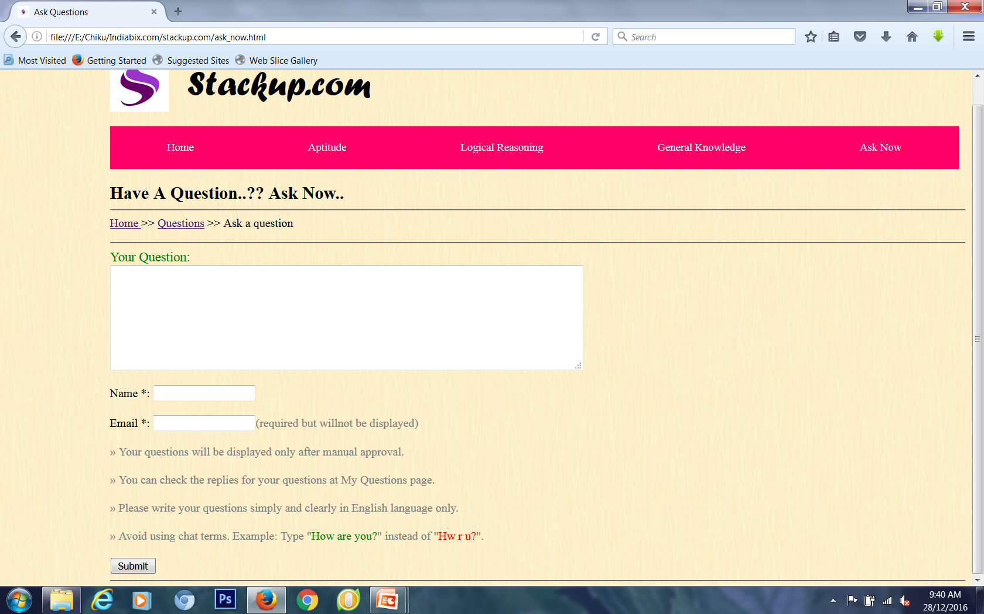
Ask Now Page

Slide 10

Some Basic Tags Used
<!DOCTYPE html> : This declaration defines this document to be HTML 5.
<html> : This element is the root element of the html page.
<head> : This element contains meta information about the document
<title> : This element specifies the title of the document.
<body>: This element contains visible page content.

Slide 11

<img> : This tag is used to add image to html pages.
<marquee>: This tag is used to scroll text in webpages.
<div> : This tag is used to make a separate division for designing.
<a> : This tag is used to add link and jump to another webpage.
<center>: This tag is used to place text in center.
<ol> : This is tage used for ordered list
<ul> : This is tag used for unordered list.

Slide 12
Basic Properties of CSS
<style> : The CSS properties used in html are written under this tag.
CSS Properties :-
Background-color : set background for tags, ids or class.
Float : sets content to a side.
Text-align: aligns text
margin: sets margin from both the sides.
Height: sets height of a tag, id or class.
Padding : sets distances of text from margin
Width: sets width of text of tag, id or class.
Font-family: sets font style of text.

Slide 13
REFRENCES
https://onlinetestseriesmadeeasy.in/AllIndiaTestSeries2017
http://www.careerlauncher.com/cattestseries/
https://www.simplylearnt.com/examination/IIT-JEE/practice_tests

Slide 14
Thank you..!!

